Slide 1
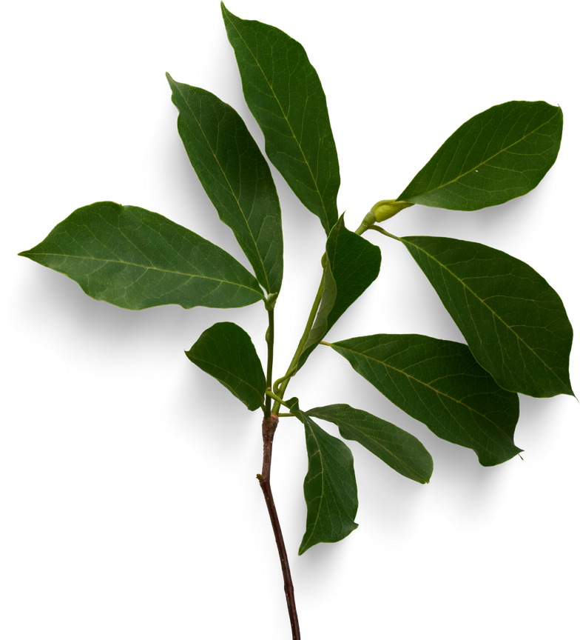
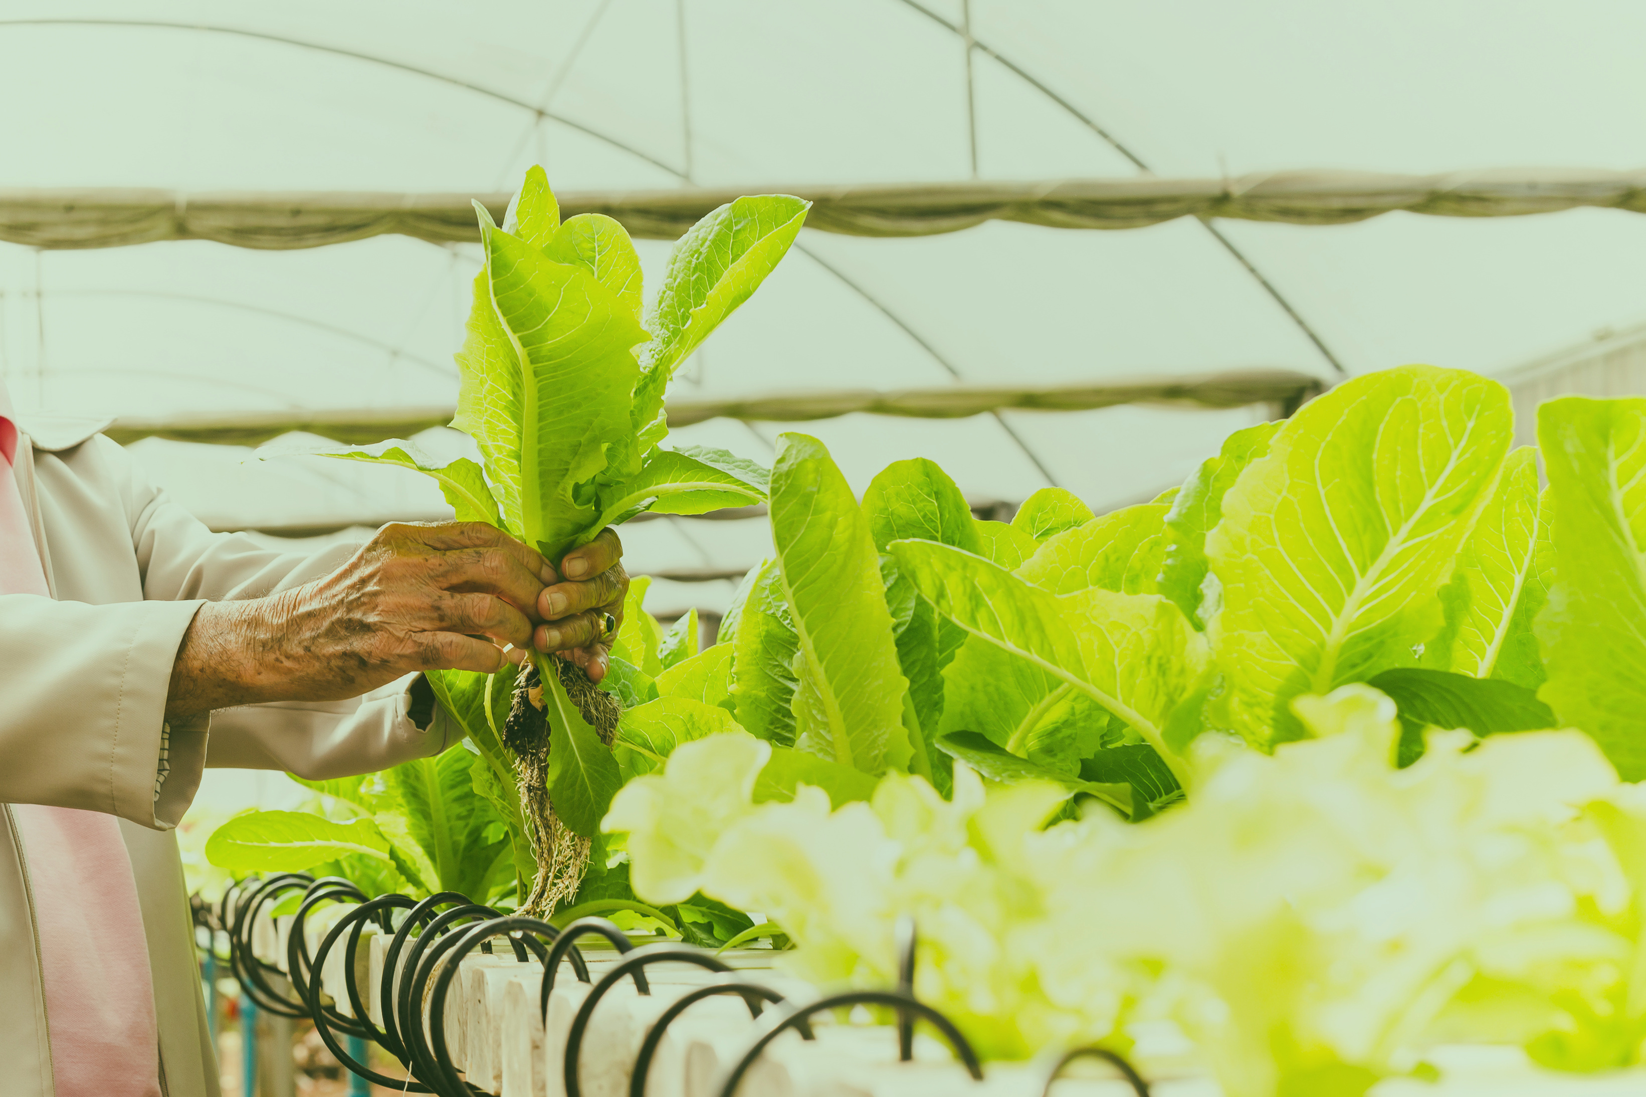


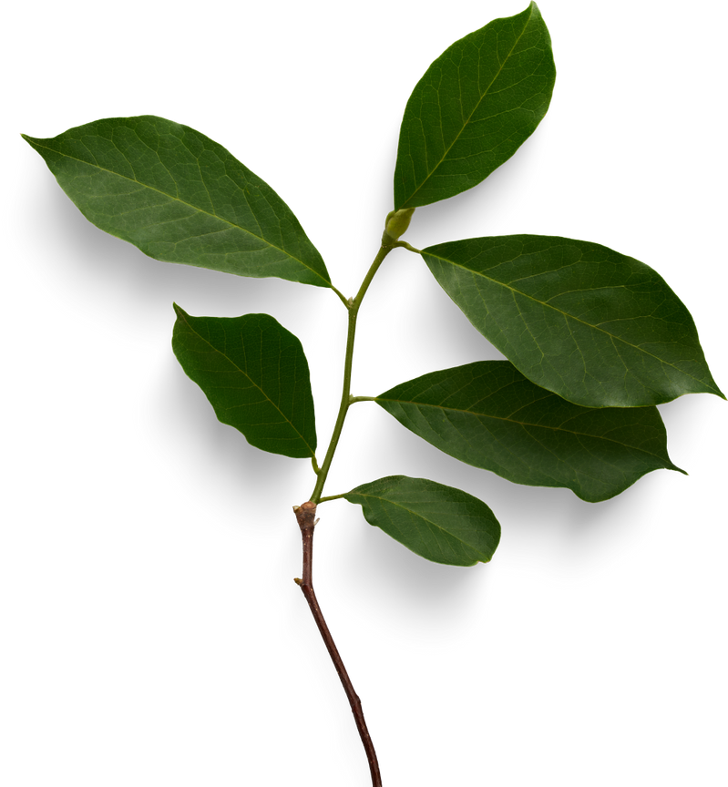

FODYA
THE GOLDEN LEAF
ZIMBABWE’S TOBACCO MARKET TRENDS :ISTHE GOLDEN LEAF STILL PROFITABLE
BY PRISCILLAH CHAMAONA AND PHILIPA MURINDAGOMO

Slide 2
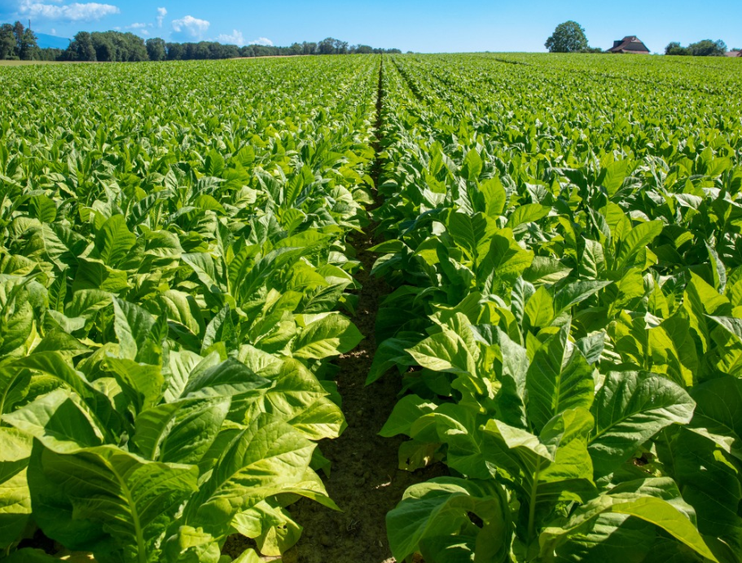

ZIMBABWE’S TOBACCO MARKET
INTRODUCTION
Zimbabwe is Africa’s top tobacco producer and consistently ranks among the top five exporters globally, after countries like China and Brazil.
The crop is often called the “golden leaf” because it is the largest foreign currency earner in agriculture, contributing over 10% of national GDP at its peak.
Tobacco accounts for 60%+ of agricultural export earnings, making it a cornerstone of Zimbabwe’s economy.
The industry supports over 125,000 registered growers, mostly smallholder farmers who depend on tobacco for their livelihoods.
Tobacco exports primarily go to China, South Africa, and Europe, strengthening Zimbabwe’s trade balance.
However, the sector is highly vulnerable:
• Climate shocks (droughts, erratic rainfall, changing seasons).
• Economic instability (hyperinflation, currency depreciation).
• Global shifts (anti-smoking policies, ESG concerns, alternative crops).

Slide 3
THE GOLDEN LEAF
WHY THIS ANALYSIS ?
Tobacco is Zimbabwe’s economic backbone, but its stability is questioned.
Climate change → shifting rainfall patterns, droughts, unpredictable seasons.
Economic instability → high inflation, currency volatility, rising production costs.
General wisdom says: “climate & economy affect everything.”
But do they significantly affect Zimbabwe’s tobacco market?
This analysis aims to quantify:
How much climate (rainfall) impacts sales and production.
How much inflation shapes pricing and profitability.
Ultimately, we ask:
“Is the golden leaf still sustainable and profitable under these pressures?”

Slide 4
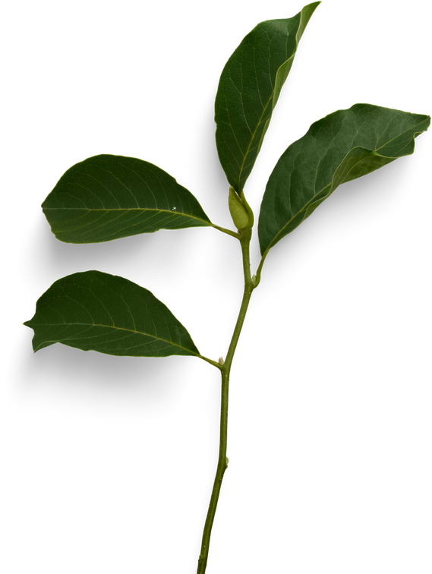
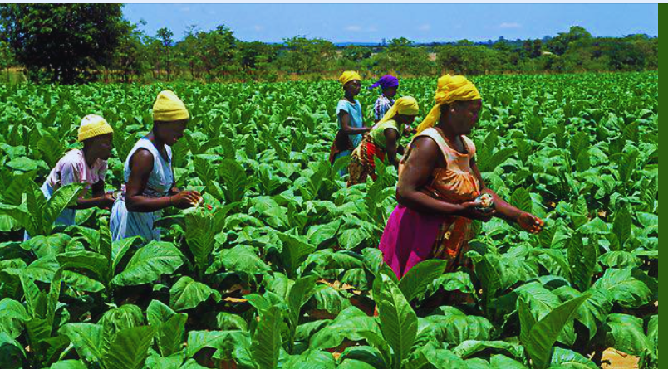
THE GOLDEN LEAF
OBEJECTIVES
Analyze historical tobacco sales volumes and prices (2020–2025).
• Identify and interpret seasonal and annual trends.
• Quantify the impact of climate (rainfall) on sales and production.
• Measure the role of economic instability (inflation) on prices and profitability.
• Forecast future market trends under different scenarios.
• Provide recommendations for farmers, policymakers, and investors.

Slide 5
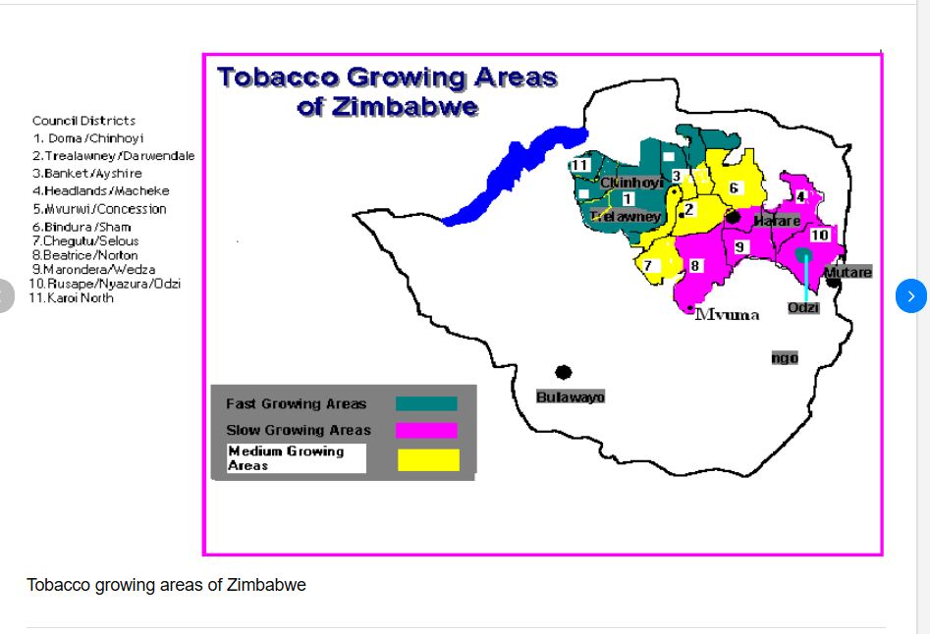
THE GOLDEN LEAF
DATA & METHODOLOGY
Data Sources (2020–2025)
• Tobacco Sales & Prices → TIMB, ZIMSTAT
• Rainfall (Climate Data) → CHIRPS / Zimbabwe Meteorological Services
• Inflation (Economic Data) → ZIMSTAT, World Bank
Methodology
• Data Cleaning & Alignment → Annual/seasonal aggregation for comparability
• Exploratory Data Analysis (EDA) → Trends, correlations, anomalies
• Statistical Analysis → Correlation, regression (rainfall & inflation vs sales & prices)
• Forecasting Models → ARIMA/Prophet for price and sales predictions
• Visualization → Time-series graphs, scatter plots, correlation matrices

Slide 6
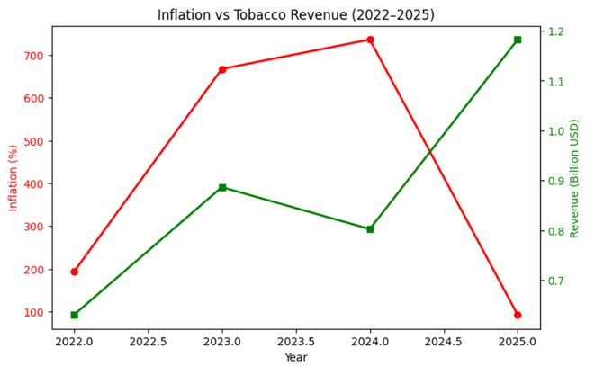
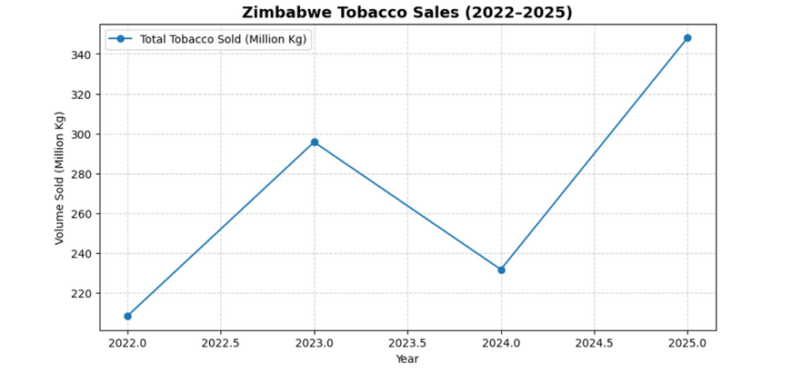
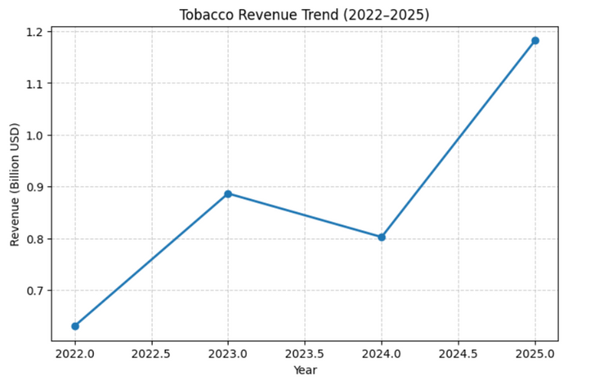
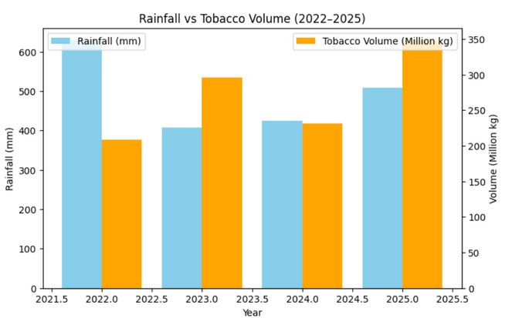
THE GOLDEN LEAF
OUR DATA INSIGHTS
VOLUMES
• Sales increased from ~208M kg (2022) → ~296M kg (2023) → dipped in 2024 → peaked at ~348M kg (2025)
2. Revenue
• Strong upward trend, highest in 2025: >$1.18B
• 2024 dip in volume offset by higher prices
3. Rainfall vs Volume
• 2022: High rainfall (628mm) → lower sales
• 2023: Low rainfall (408mm) → higher sales
• Indicates rainfall isn’t a direct driver of sales; market demand and inputs matter
4. Inflation Impact
• Inflation peaked 2023–2024 (600–700%) → volumes remained strong
• 2025: Inflation dropped to 92% → volume & revenue surged → healthier economy aids growth

Slide 7
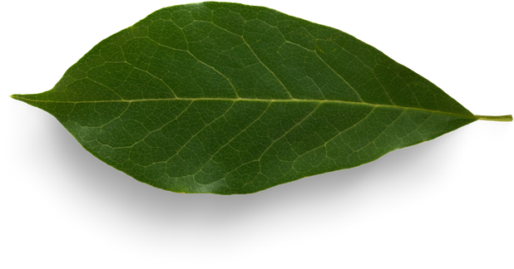
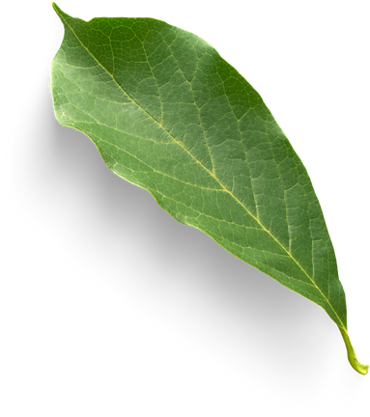
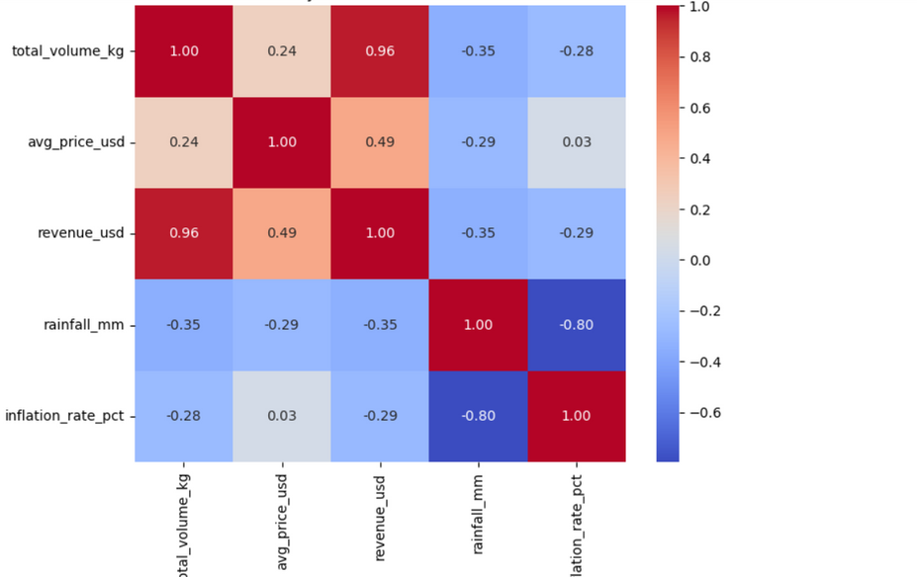
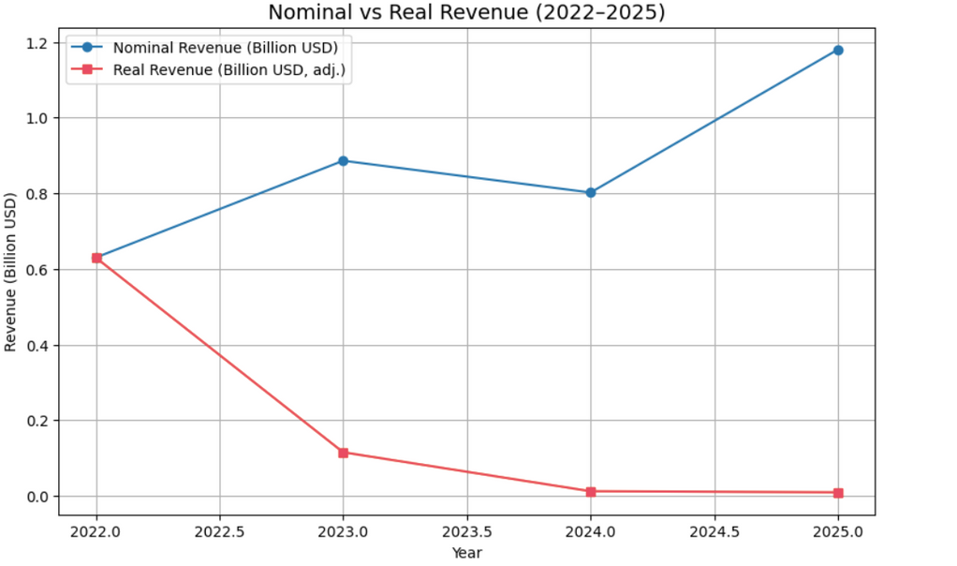
THE GOLDEN LEAF
CORRELATION &TREND ANALYSIS
Revenue tracks volume (≈0.96 correlation) → growth driven by scale, not efficiency
Rainfall affects production; inflation drives profitability
Major shocks (2019 drought, 2020–21 hyperinflation, 2023–24 spikes) distort markets
Sector resilient to climate, vulnerable to economic instability → real earnings often decline despite nominal revenue growth
Bottom line: Inflation and macro conditions matter more than volumes or climate .
Zimbabawe looks like it’s earning more in USD , but after inflation adjustments , farmers’ and exporters’ real earnings plummer drastically.

Slide 8


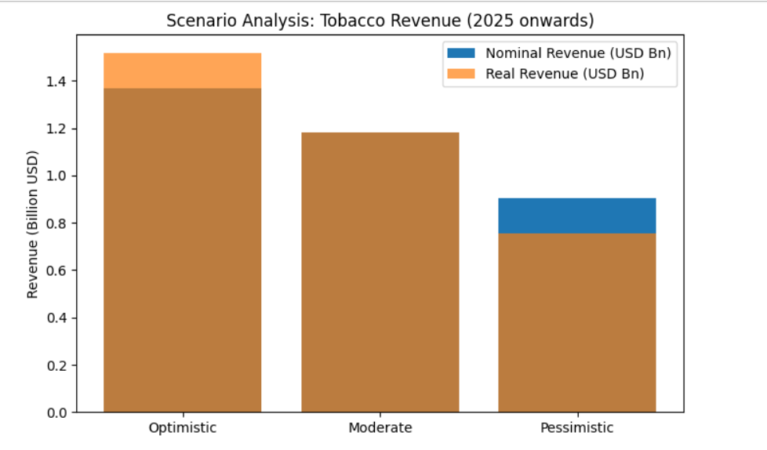

THE GOLDEN LEAF
SCENARIO ANALYSIS
Instead of a forecasting model, we did a scenario analysis , due to limitations in our sales datasets ( 2020-2025). With only 4 years of usable sales data, any forecast would be shaky(too much noise , not enough history)
Rainfall + Inflation = Game changers.
In a good year, tobacco is a billion-dollar crop .
In a bad year, profits can shrink almost by half.
This shows why climate resilience (like irrigation) and economic stability (low inflation) are crucial for Zimbabwe’s “golden leaf.”

Slide 9
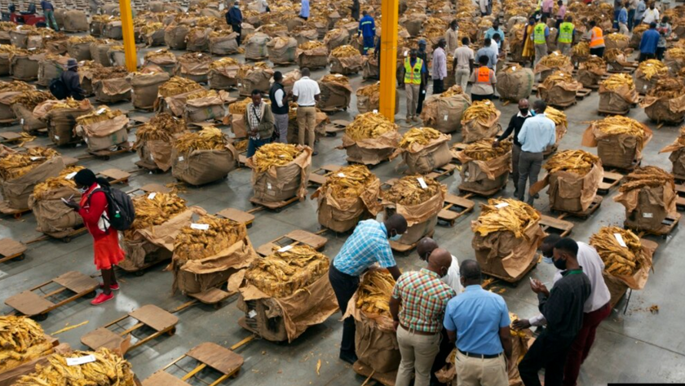
THE GOLDEN LEAF
RECOMMENDATIONS
FOR FARMERS
FOR INVESTORS &POLICYMARKERS
DIVERSIFY CROPS (REDUCE OVER-RELIANCE ON TOBACCO).
Invest in irrigation and water-saving techniques to cushion against erratic rainfall.
Strengthen bargaining power through cooperatives to reduce dependency on unfair contract terms.
Ensure fair, transparent contract systems.
Stabilize prices & protect against inflation shocks.
Invest in irrigation, climate-smart tech & rural infrastructure.
Support export diversification & sustainable practices.
“A resilient tobacco sector requires fairness, transparency, and climate-smart investment—only then will the golden leaf remain truly golden.”

Slide 10
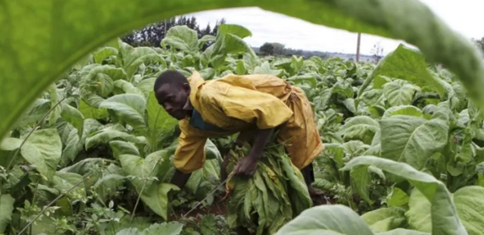
CONCLUSION
Zimbabwe’s tobacco sector continues to generate billions in revenue, proving that the golden leaf is still profitable on paper. However, this profitability is not evenly shared. Farmers, the backbone of production, often remain trapped in debt, weighed down by lender contracts, high input costs, and undervalued labor.
The real question is: profitable for whom? The industry thrives, exporters and investors benefit, but farmers are left behind. Without reforms to make the value chain fairer and more transparent, Zimbabwe risks sustaining an industry where farmers carry the burden while others reap the rewards.
The future of the golden leaf should not only be measured by export dollars, but by whether the farmer in the field goes home with dignity and profit.

Slide 11
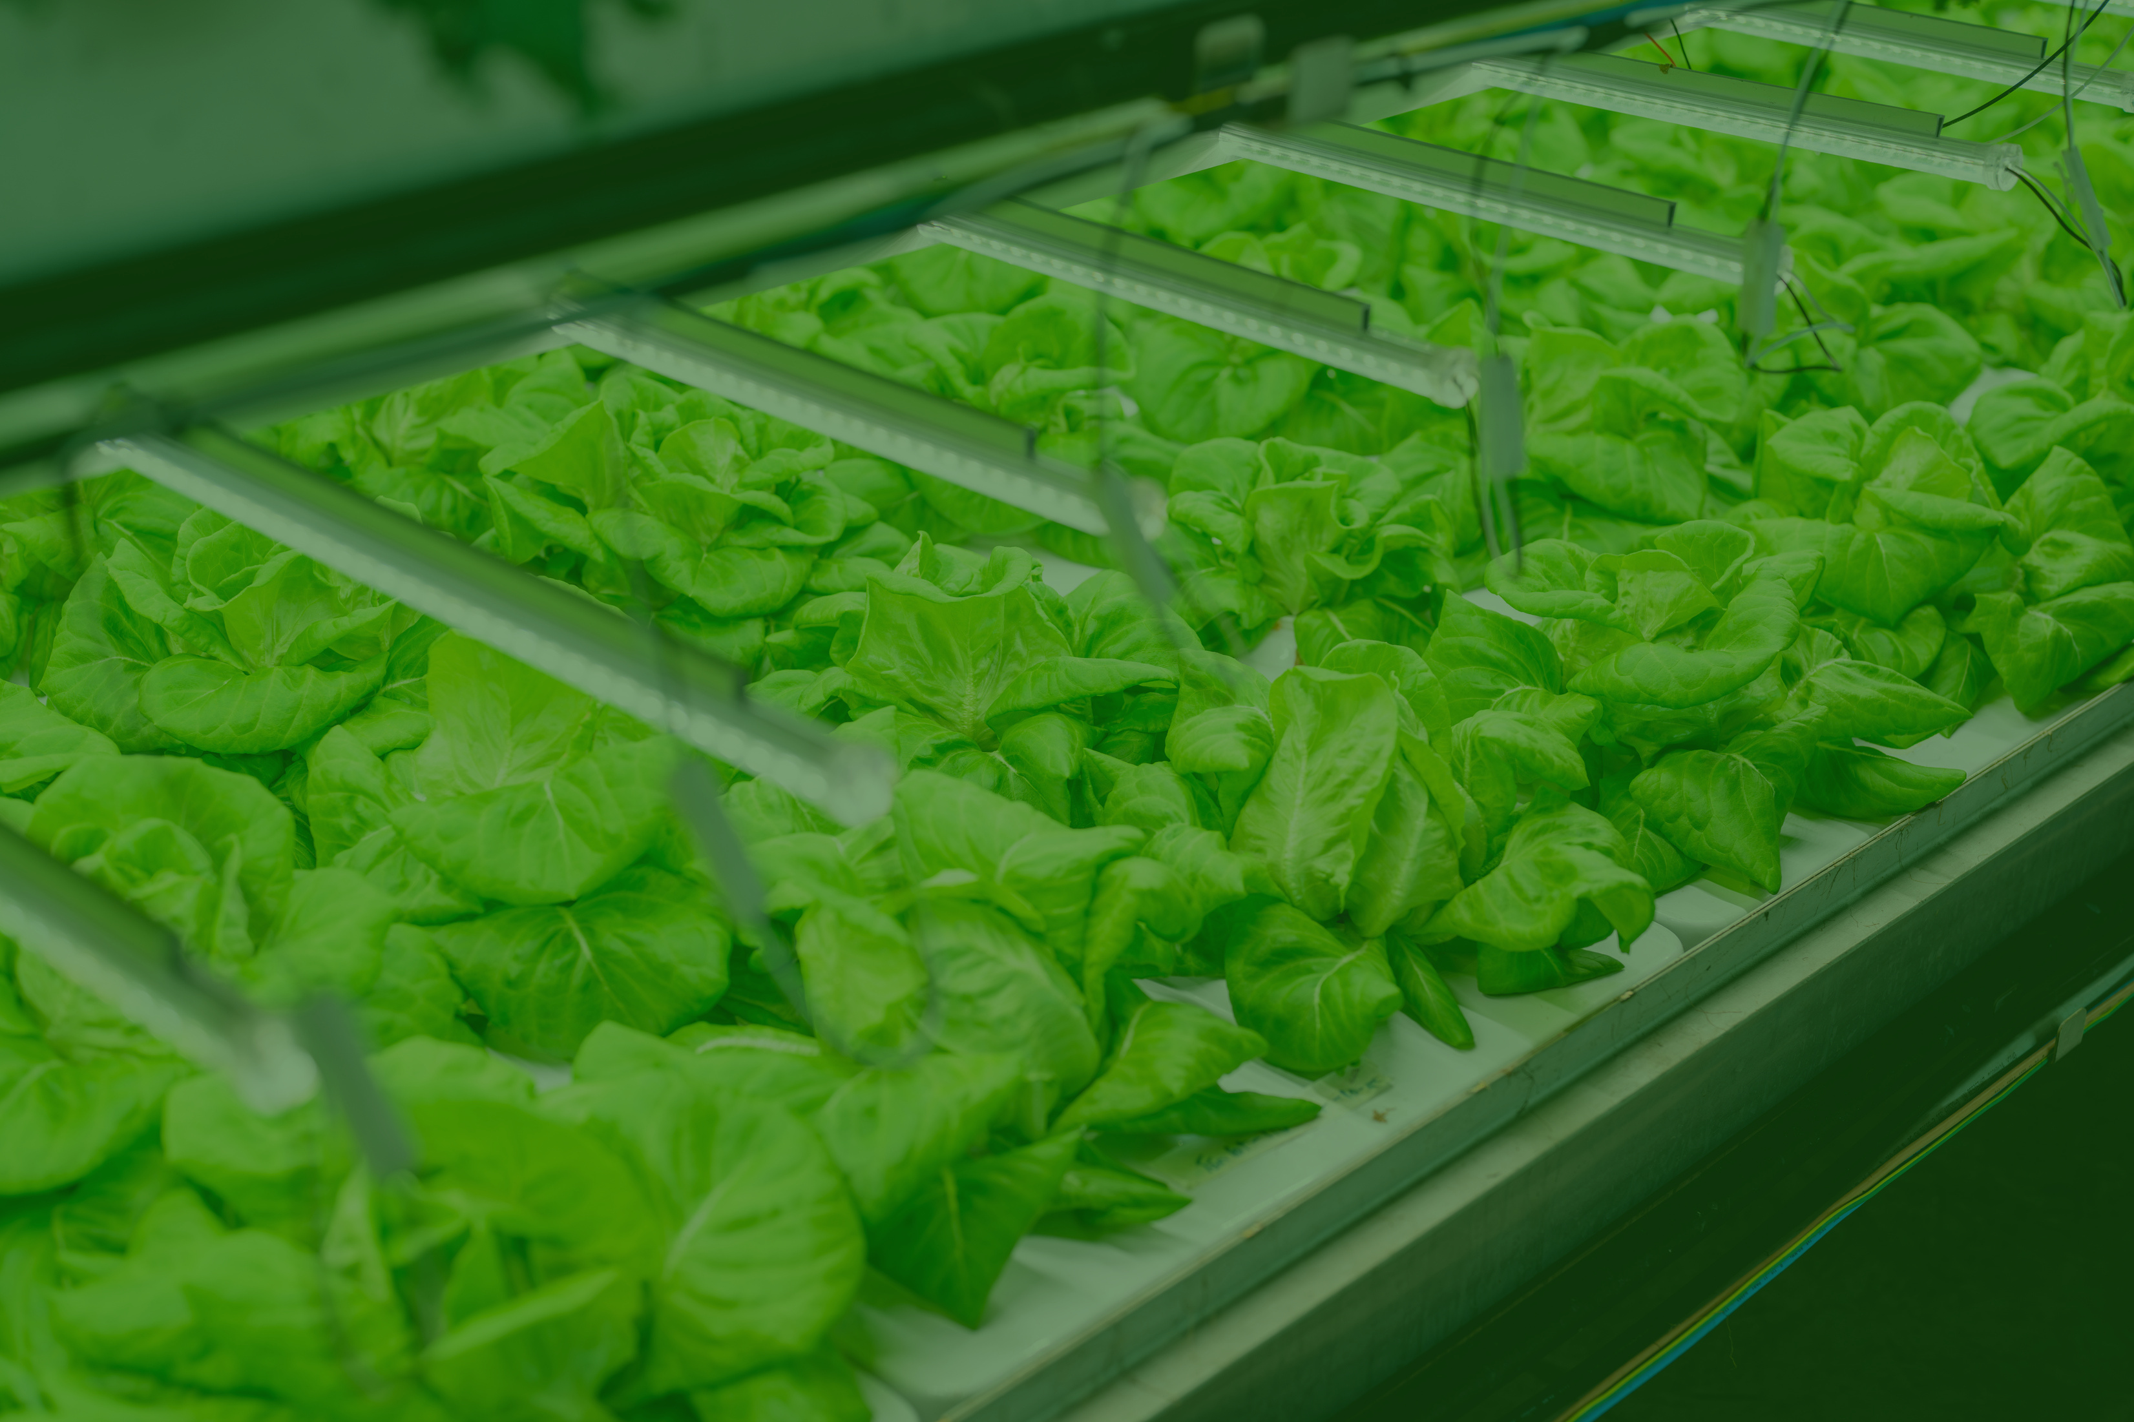
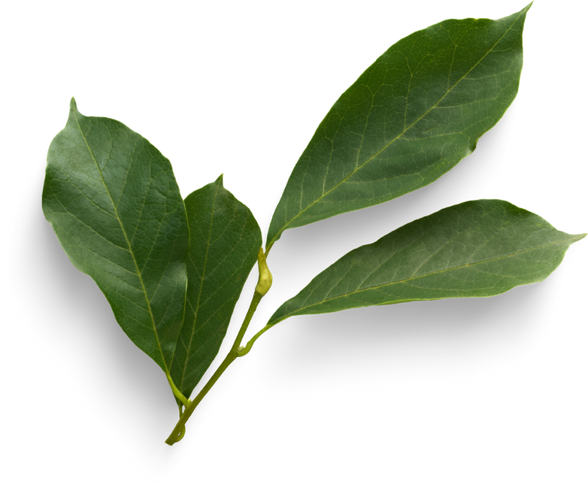
THE GOLDEN LEAF
THANK YOU
DONE BY PHILIPA & PRISCILLAH

